Slide 1

Gene Expression Analysis with GTEx Aria Fernandez, Karl Mayo

Slide 2
What are we doing here?
Goal: See if there are any interesting differences in the amygdala based on age
Datasets: Amygdala, Annotations used for age data
Age data is clustered automatically into 10-year chunks, ie 0-9, 10-19, 20-29, etc
Techniques include: Data wrangling, heavy use of tidyverse, visualization, heat maps

Slide 3
Overview of code
Create function to dynamically read and clean each dataset
Includes commenting out shape data of the given matrices
Combine amygdala and annotations data
Move age category to the front of the dataset for easier searching
Take the average of each gene in each age range
Make heat map based on those age range averages

Slide 4

And now, for our findings

Slide 5
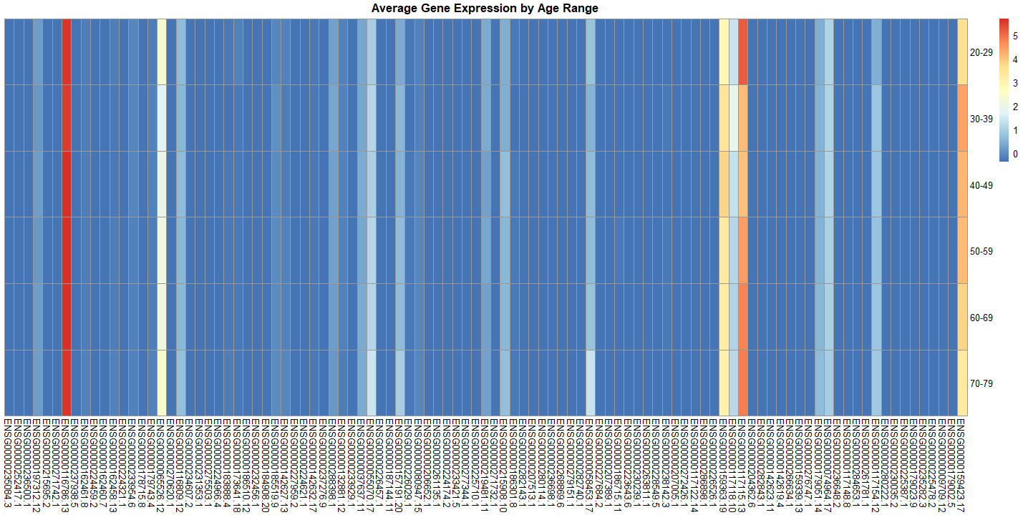
Sliced from 500:600

Slide 6
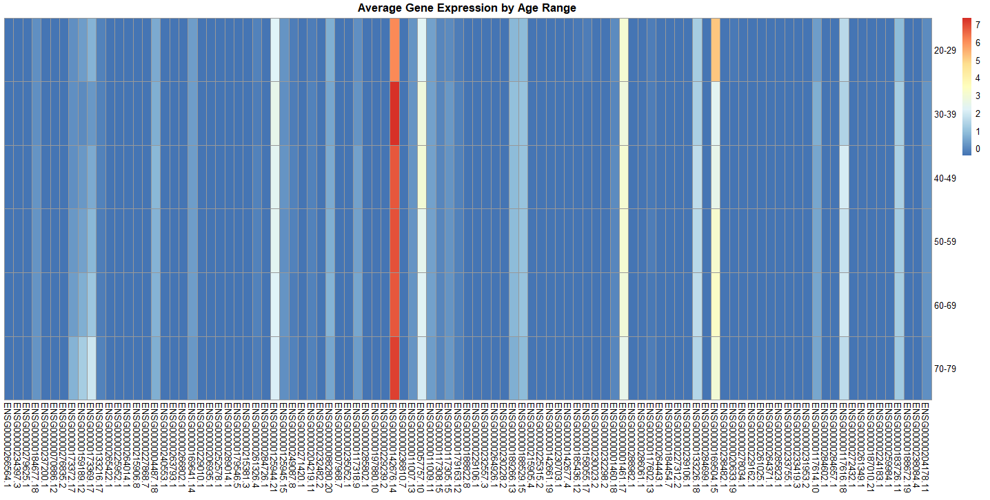
Sliced from 700:800

Slide 7
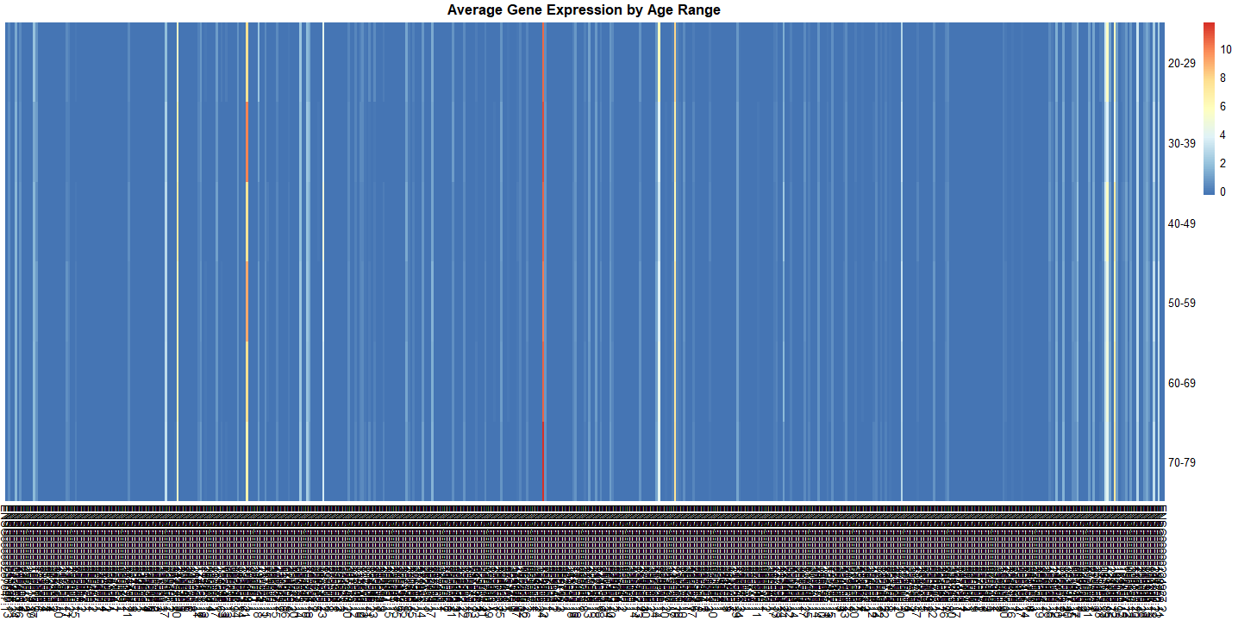
Sliced from 2000:2500 to show patterns

Slide 8

What does it mean?
Despite what common sense may lead us to conclude, a large number of these gene expressions seemed to increase with age rather than decrease.
We don’t currently have enough evidence to state any causation behind this, if there is one.

Slide 9
The future
Explore other regions such as the hippocampus
Focus on gene groups specifically related to aging
Isolate genes with high variation across age ranges

Slide 10

The end! Thank you!

